Slide 1




SmartPark:
AI-Driven AIoT Parking Solution for Apartment Communities.
Framed by:
Realized by:
Mohamed EL BRAK
Salma NIDAR
Aymane MAHRI
Ayoub BAKKALI
Mohamed Amine SABBAHI

Slide 2

summary
01 - whats Smart Park ?
02 - Problematic
03 - The Need for Innovative Solutions
04 - Methodology
05 - Practical example
06 - Conclusions

Slide 3
01 - whats Smart Park ?
SmartPark is an innovative parking management solution designed specifically for apartment communities in urban areas.
One of the key features of SmartPark is its intuitive dashboard interface, which provides users with a user-friendly platform to view parking availability and receive instant notifications.

Slide 4
02 - Problematic
Urban apartment parking: Limited space, rising resident demands.
Traditional methods: Manual allocation, outdated tech = inefficiencies.
Real-time visibility lacking: Residents circle for spots, worsens congestion.
Peak hours, events: Unpredictable demand, worsens competition.
Current infrastructure inadequate: Unsustainable, low resident satisfaction.
Need proactive, adaptive approach: Address congestion, shortages, inefficiencies.

Slide 5

03 - The Need for Innovative Solutions:
Complexities of Modern Urban Living.
Limitations of Traditional Methods.
Real-Time Visibility.
Enhanced Resident Experience.
Waste of Time.

Slide 6
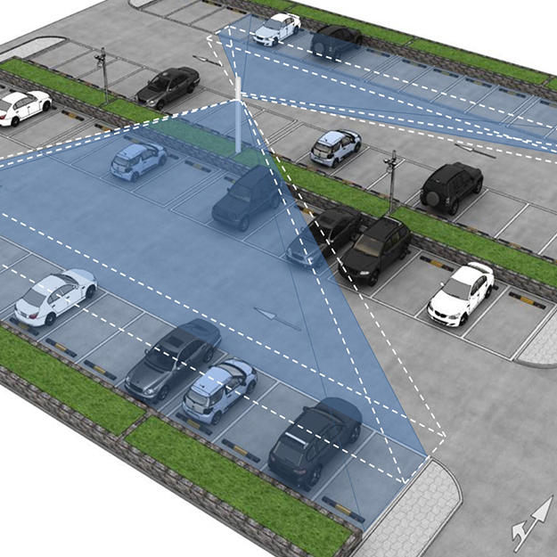
04 - Methodology
At the core of our solution is a system designed to process images captured from strategically positioned video cameras. These cameras are typically installed in elevated locations to provide comprehensive coverage of the parking area.
The images are then processed to identify whether cars are parked or not and to notify the user if the parking area is full.

Slide 7
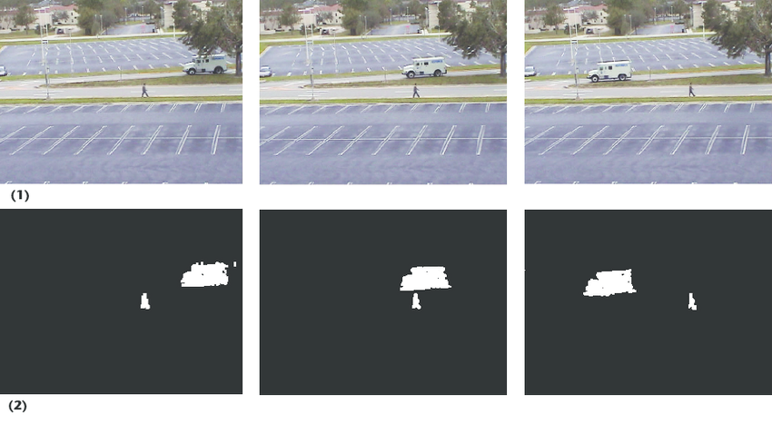
Object detection
The first phase of is identifting vehicules captured by cameras, we achieve this by background substraction that compared frames and detecting deviations, indicating a moving object.
This process, known as background subtraction, isolates foreground pixels, focusing attention on areas containing potential objects of interest.

Slide 8
Contour detection
By identifying object boundaries based on pixel intensity and spatial coherence, contour detection algorithms, such as those in OpenCV, analyze video feeds or static images from surveillance cameras. This process isolates regions of interest indicative of cars, enabling the system to delineate their outlines regardless of orientation or scale. Extracted contours provide geometric descriptors, facilitating real-time analysis of car size, shape, and spatial distribution.

Slide 9

Email Integration
The integration of email notifications into the parking lot detection system offers a seamless and efficient means of communicating parking availability to users. By leveraging email, the system can provide timely updates on parking status, enabling drivers to make informed decisions about parking.

Slide 10
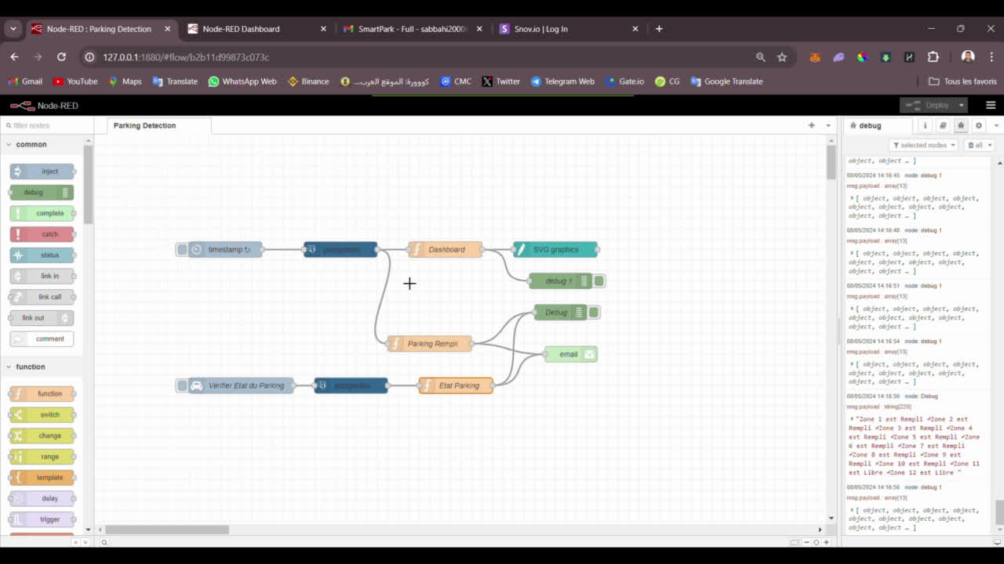
05 - Practical example:
In this video, we will showcase a live demonstration and practical example of the SmartPark app in action.

Slide 11
06 - Conclusions
SmartPark: Revolutionizing Parking Management. Seamlessly integrating Node-RED, PostgreSQL, and AI-driven OpenCV, SmartPark empowers residents with real-time updates, intuitive dashboards, and personalized notifications. Enhanced security, reduced congestion, and scalability make SmartPark the solution for modern urban living.

Slide 12
Thanks

